Slide 1
Hi! This is CS50.
On today's breaktime menu, cookies with GF and vegan options.
CS50 Lunch this Fri 10/4, 1:15pm, RSVP at cs50.harvard.edu/lunch to attend.
If you have trouble seeing projector, see live.cs50.io/screen for live feed.
Quiz 4 due tomorrow at 10:30am.
Problem Set 4 due Sun 10/6 at 11:59pm.
Supersection tonight at 7:30pm via Zoom.
Lots of tutorials available this week!
CS50's October Recess is Mon 10/14 through Sun 10/20. No lecture, section, or pset that week.

Slide 2
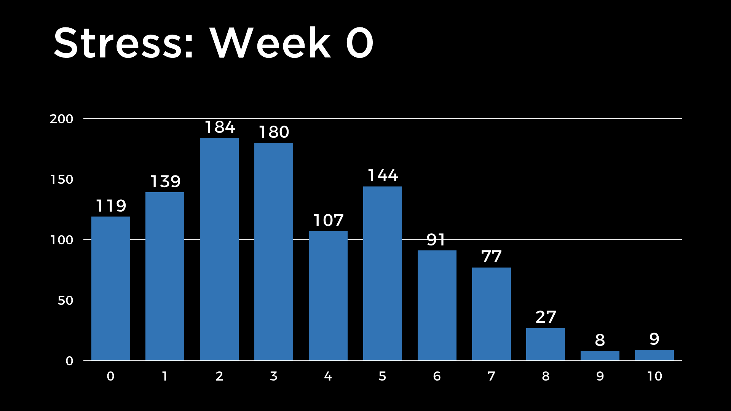

Slide 3
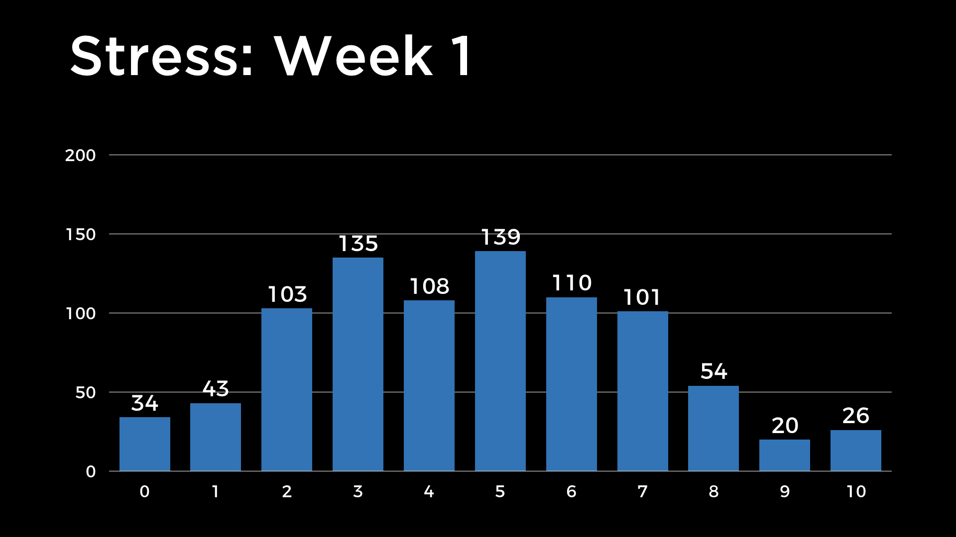

Slide 4
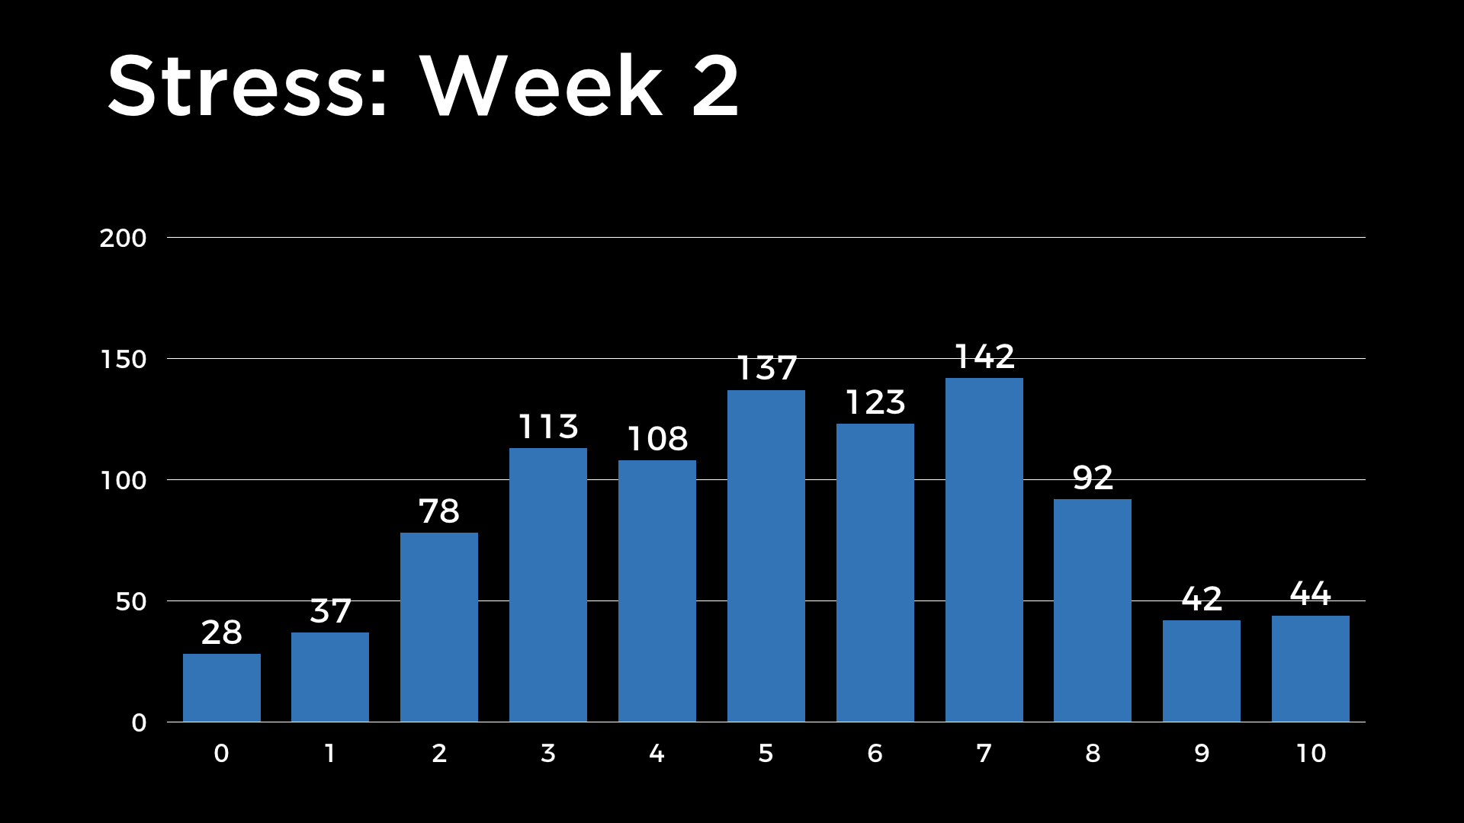

Slide 5
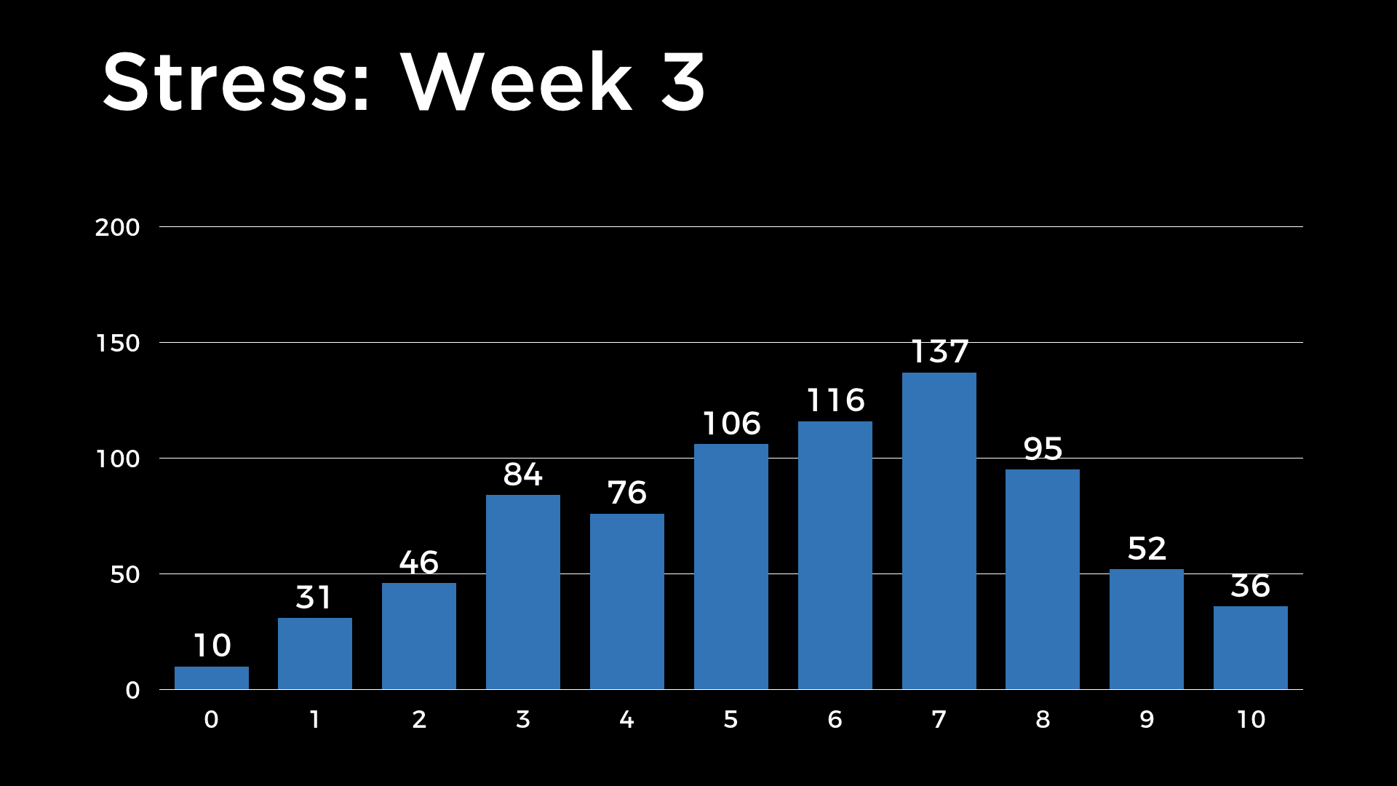

Slide 6
This is CS50
Notes:
Lots of comparing and swapping last time...

Slide 8
0 | 1 | 2 | 3 | 4 | 5 | 6 | 7
8 | 9 | 10 | 11 | 12 | 13 | 14 | 15
16 | 17 | 18 | 19 | 20 | 21 | 22 | 23
24 | 25 | 26 | 27 | 28 | 29 | 30 | 31

Slide 9
0 | 1 | 2 | 3 | 4 | 5 | 6 | 7
8 | 9 | 10 | 11 | 12 | 13 | 14 | 15
16 | 17 | 18 | 19 | 20 | 21 | 22 | 23
24 | 25 | 26 | 27 | 28 | 29 | 30 | 31

Slide 10
0 | 1 | 2 | 3 | 4 | 5 | 6 | 7
8 | 9 | 10 | 11 | 12 | 13 | 14 | 15
16 | 17 | 18 | 19 | 20 | 21 | 22 | 23
24 | 25 | 26 | 27 | 28 | 29 | 30 | 31

Slide 11
0 | 1 | 2 | 3 | 4 | 5 | 6 | 7
8 | 9 | 10 | 11 | 12 | 13 | 14 | 15
16 | 17 | 18 | 19 | 20 | 21 | 22 | 23
24 | 25 | 26 | 27 | 28 | 29 | 30 | 31

Slide 12
0 | 1 | 2 | 3 | 4 | 5 | 6 | 7
8 | 9 | 10 | 11 | 12 | 13 | 14 | 15
16 | 17 | 18 | 19 | 20 | 21 | 22 | 23
24 | 25 | 26 | 27 | 28 | 29 | 30 | 31

Slide 13
0 | 1 | 2 | 3 | 4 | 5 | 6 | 7
8 | 9 | 10 | 11 | 12 | 13 | 14 | 15
16 | 17 | 18 | 19 | 20 | 21 | 22 | 23
24 | 25 | 26 | 27 | 28 | 29 | 30 | 31

Slide 14
0 | 1 | 2 | 3 | 4 | 5 | 6 | 7
8 | 9 | 10 | 11 | 12 | 13 | 14 | 15
16 | 17 | 18 | 19 | 20 | 21 | 22 | 23
24 | 25 | 26 | 27 | 28 | 29 | 30 | 31

Slide 15
0 | 1 | 2 | 3 | 4 | 5 | 6 | 7
8 | 9 | 10 | 11 | 12 | 13 | 14 | 15
16 | 17 | 18 | 19 | 20 | 21 | 22 | 23
24 | 25 | 26 | 27 | 28 | 29 | 30 | 31

Slide 16
0 | 1 | 2 | 3 | 4 | 5 | 6 | 7
8 | 9 | 10 | 11 | 12 | 13 | 14 | 15
16 | 17 | 18 | 19 | 20 | 21 | 22 | 23
24 | 25 | 26 | 27 | 28 | 29 | 30 | 31

Slide 17
0 | 1 | 2 | 3 | 4 | 5 | 6 | 7
8 | 9 | 10 | 11 | 12 | 13 | 14 | 15
16 | 17 | 18 | 19 | 20 | 21 | 22 | 23
24 | 25 | 26 | 27 | 28 | 29 | 30 | 31

Slide 18
0 | 1 | 2 | 3 | 4 | 5 | 6 | 7
8 | 9 | 10 | 11 | 12 | 13 | 14 | 15
16 | 17 | 18 | 19 | 20 | 21 | 22 | 23
24 | 25 | 26 | 27 | 28 | 29 | 30 | 31

Slide 19
0 | 1 | 2 | 3 | 4 | 5 | 6 | 7
8 | 9 | 10 | 11 | 12 | 13 | 14 | 15
16 | 17 | 18 | 19 | 20 | 21 | 22 | 23
24 | 25 | 26 | 27 | 28 | 29 | 30 | 31

Slide 20
0 | 1 | 2 | 3 | 4 | 5 | 6 | 7
8 | 9 | 10 | 11 | 12 | 13 | 14 | 15
16 | 17 | 18 | 19 | 20 | 21 | 22 | 23
24 | 25 | 26 | 27 | 28 | 29 | 30 | 31

Slide 21
0 | 1 | 2 | 3 | 4 | 5 | 6 | 7
8 | 9 | 10 | 11 | 12 | 13 | 14 | 15
16 | 17 | 18 | 19 | 20 | 21 | 22 | 23
24 | 25 | 26 | 27 | 28 | 29 | 30 | 31

Slide 22
0 | 1 | 2 | 3 | 4 | 5 | 6 | 7
8 | 9 | 10 | 11 | 12 | 13 | 14 | 15
16 | 17 | 18 | 19 | 20 | 21 | 22 | 23
24 | 25 | 26 | 27 | 28 | 29 | 30 | 31

Slide 23
0 | 1 | 2 | 3 | 4 | 5 | 6 | 7
8 | 9 | 10 | 11 | 12 | 13 | 14 | 15
16 | 17 | 18 | 19 | 20 | 21 | 22 | 23
24 | 25 | 26 | 27 | 28 | 29 | 30 | 31

Slide 25
0 | 1 | 2 | 3 | 4 | 5 | 6 | 7
8 | 9 | 10 | 11 | 12 | 13 | 14 | 15
16 | 17 | 18 | 19 | 20 | 21 | 22 | 23
24 | 25 | 26 | 27 | 28 | 29 | 30 | 31

Slide 26
0 | 1 | 2 | 3 | 4 | 5 | 6 | 7
8 | 9 | 10 | 11 | 12 | 13 | 14 | 15
16 | 17 | 18 | 19 | 20 | 21 | 22 | 23
24 | 25 | 26 | 27 | 28 | 29 | 30 | 31

Slide 27
0 | 1 | 2 | 3 | 4 | 5 | 6 | 7
8 | 9 | 10 | 11 | 12 | 13 | 14 | 15
16 | 17 | 18 | 19 | 20 | 21 | 22 | 23
24 | 25 | 26 | 27 | 28 | 29 | 30 | 31

Slide 28
0 | 1 | 2 | 3 | 4 | 5 | 6 | 7
8 | 9 | 10 | 11 | 12 | 13 | 14 | 15
16 | 17 | 18 | 19 | 20 | 21 | 22 | 23
24 | 25 | 26 | 27 | 28 | 29 | 30 | 31

Slide 29
0 | 1 | 2 | 3 | 4 | 5 | 6 | 7
8 | 9 | 10 | 11 | 12 | 13 | 14 | 15
16 | 17 | 18 | 19 | 20 | 21 | 22 | 23
24 | 25 | 26 | 27 | 28 | 29 | 30 | 31

Slide 30
0 | 1 | 2 | 3 | 4 | 5 | 6 | 7
8 | 9 | 10 | 11 | 12 | 13 | 14 | 15
16 | 17 | 18 | 19 | 20 | 21 | 22 | 23
24 | 25 | 26 | 27 | 28 | 29 | 30 | 31

Slide 31
0 | 1 | 2 | 3 | 4 | 5 | 6 | 7
8 | 9 | 10 | 11 | 12 | 13 | 14 | 15
16 | 17 | 18 | 19 | 20 | 21 | 22 | 23
24 | 25 | 26 | 27 | 28 | 29 | 30 | 31

Slide 32
0 | 1 | 2 | 3 | 4 | 5 | 6 | 7
8 | 9 | 10 | 11 | 12 | 13 | 14 | 15
16 | 17 | 18 | 19 | 20 | 21 | 22 | 23
24 | 25 | 26 | 27 | 28 | 29 | 30 | 31

Slide 33
0 | 1 | 2 | 3 | 4 | 5 | 6 | 7
8 | 9 | 10 | 11 | 12 | 13 | 14 | 15
16 | 17 | 18 | 19 | 20 | 21 | 22 | 23
24 | 25 | 26 | 27 | 28 | 29 | 30 | 31

Slide 34
0 | 1 | 2 | 3 | 4 | 5 | 6 | 7
8 | 9 | 10 | 11 | 12 | 13 | 14 | 15
16 | 17 | 18 | 19 | 20 | 21 | 22 | 23
24 | 25 | 26 | 27 | 28 | 29 | 30 | 31

Slide 35
0 | 1 | 2 | 3 | 4 | 5 | 6 | 7
8 | 9 | A | B | C | D | E | F
10 | 11 | 12 | 13 | 14 | 15 | 16 | 17
18 | 19 | 1A | 1B | 1C | 1D | 1E | 1F

Slide 36
0 | 1 | 2 | 3 | 4 | 5 | 6 | 7
8 | 9 | A | B | C | D | E | F
10 | 11 | 12 | 13 | 14 | 15 | 16 | 17
18 | 19 | 1A | 1B | 1C | 1D | 1E | 1F

Slide 37
0 | 1 | 2 | 3 | 4 | 5 | 6 | 7
8 | 9 | A | B | C | D | E | F
10 | 11 | 12 | 13 | 14 | 15 | 16 | 17
18 | 19 | 1A | 1B | 1C | 1D | 1E | 1F

Slide 38
0 | 1 | 2 | 3 | 4 | 5 | 6 | 7
8 | 9 | A | B | C | D | E | F
10 | 11 | 12 | 13 | 14 | 15 | 16 | 17
18 | 19 | 1A | 1B | 1C | 1D | 1E | 1F

Slide 39
0 | 1 | 2 | 3 | 4 | 5 | 6 | 7
8 | 9 | A | B | C | D | E | F
10 | 11 | 12 | 13 | 14 | 15 | 16 | 17
18 | 19 | 1A | 1B | 1C | 1D | 1E | 1F

Slide 40
0 | 1 | 2 | 3 | 4 | 5 | 6 | 7
8 | 9 | A | B | C | D | E | F
10 | 11 | 12 | 13 | 14 | 15 | 16 | 17
18 | 19 | 1A | 1B | 1C | 1D | 1E | 1F

Slide 41
0 1 2 3 4 5 6 7 8 9 A B C D E F

Slide 42
0 1 2 3 4 5 6 7 8 9 A B C D E F

Slide 43
0 1 2 3 4 5 6 7 8 9 A B C D E F

Slide 44
0 1 2 3 4 5 6 7 8 9 A B C D E F

Slide 45
2⁷
2⁶
2⁵
2⁴
2³
2²
2¹
2⁰
00000000

Slide 46
128
64
32
16
8
4
2
1
00000000

Slide 47
128
64
32
16
8
4
2
1
11111111

Slide 48
10²
10¹
10⁰
255

Slide 49
100
10
1
255

Slide 50
16¹
16⁰
FF

Slide 51
16
1
FF

Slide 52
16
1
00

Slide 53
16
1
01

Slide 54
16
1
02

Slide 55
16
1
03

Slide 56
16
1
04

Slide 57
16
1
05

Slide 58
16
1
06

Slide 59
16
1
07

Slide 60
16
1
08

Slide 61
16
1
09

Slide 62
16
1
0A

Slide 63
16
1
0B

Slide 64
16
1
0C

Slide 65
16
1
0D

Slide 66
16
1
0E

Slide 67
16
1
0F

Slide 68
16
1
10

Slide 69
16
1
11

Slide 70
16
1
12

Slide 71
16
1
13

Slide 72
16
1
14

Slide 73
16
1
15

Slide 74
16
1
16

Slide 75
16
1
17

Slide 76
16
1
18

Slide 77
16
1
19

Slide 78
16
1
1A

Slide 79
16
1
1B

Slide 80
16
1
1C

Slide 81
16
1
1D

Slide 82
16
1
1E

Slide 83
16
1
1F

Slide 84
16
1
20

Slide 85
16
1
FF

Slide 86
16
1
FF
16 × F
+
1 × F

Slide 87
16
1
FF
16 × 15
+
1 × 15

Slide 88
16
1
FF
240
+
15

Slide 89
16
1
FF
255

Slide 90
100
10
1
255

Slide 91
128
64
32
16
8
4
2
1
11111111

Slide 92
RGB

Slide 94
00 | 00 | 00

Slide 95
FF | 00 | 00

Slide 96
00 | FF | 00

Slide 97
00 | 00 | FF

Slide 98
FF | FF | FF

Slide 99
0 | 1 | 2 | 3 | 4 | 5 | 6 | 7
8 | 9 | A | B | C | D | E | F
10 | 11 | 12 | 13 | 14 | 15 | 16 | 17
18 | 19 | 1A | 1B | 1C | 1D | 1E | 1F

Slide 100
0x0 | 0x1 | 0x2 | 0x3 | 0x4 | 0x5 | 0x6 | 0x7
0x8 | 0x9 | 0xA | 0xB | 0xC | 0xD | 0xE | 0xF
0x10 | 0x11 | 0x12 | 0x13 | 0x14 | 0x15 | 0x16 | 0x17
0x18 | 0x19 | 0x1A | 0x1B | 0x1C | 0x1D | 0x1E | 0x1F

Slide 101
int n = 50;
Notes:
address0.c

Slide 103
 |  |  |  | 50 n

Slide 104
 |  |  |  | 50 0x12345678

Slide 105
pointers
Notes:
address{1,2}.c

Slide 106
&
*

Slide 107
int n = 50;
int *p = &n;
Notes:
address{3,4}.c

Slide 109
 |  |  |  | 50 n

Slide 110
 |  |  |  | 50 0x12345678

Slide 111
0x12345678 p
 |  |  |  | 50 0x12345678

Slide 112
0x12345678 p
 |  |  |  | 50 0x12345678

Slide 113
p
 |  |  |  | 50 0x12345678

Slide 114
string

Slide 115
string s = "EMMA";

Slide 116
 |  |  | E | M | M | A | \0

Slide 117
 |  |  | E s[0] | M s[1] | M s[2] | A s[3] | \0 s[4]

Slide 118
 |  |  | E 0x123 | M 0x124 | M 0x125 | A 0x126 | \0 0x127

Slide 119
0x123 s
 |  |  | E 0x123 | M 0x124 | M 0x125 | A 0x126 | \0 0x127
Notes:
address{5,6,7}.c

Slide 120
s
 |  |  | E 0x123 | M 0x124 | M 0x125 | A 0x126 | \0 0x127

Slide 121
s
 |  |  | E 0x123 | M 0x124 | M 0x125 | A 0x126 | \0 0x127

Slide 122
s
 |  |  | E 0x123 | M 0x124 | M 0x125 | A 0x126 | 00000000 0x127

Slide 123
string

Slide 124
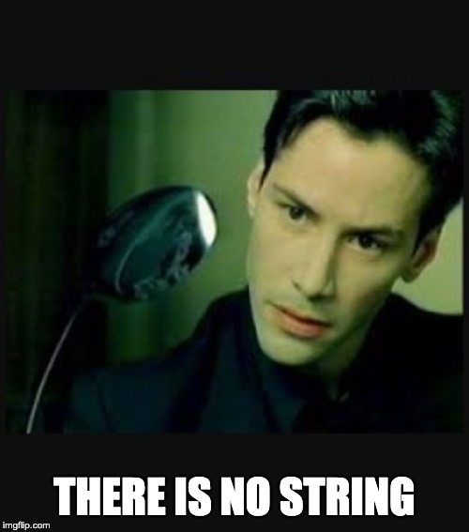

Slide 125
int n = 50;

Slide 126
int n = 50;
int *p = &n;

Slide 127
int n = 50;
int *p = &n;

Slide 128
int n = 50;
int *p = &n;

Slide 129
string s = "EMMA";

Slide 130
char *s = "EMMA";

Slide 131
char *s = "EMMA";

Slide 132
typedef struct
{
string name;
string number;
}
person;

Slide 133
typedef struct
{
string name;
string number;
}
person;

Slide 134
typedef struct
{
string name;
string number;
}
person;

Slide 135
typedef struct
{
string name;
string number;
}
person;

Slide 136
typedef char *string;

Slide 137
typedef char *string;

Slide 138
typedef char *string;

Slide 139
typedef char *string;
Notes:
address{8,9,10}.c

Slide 140
pointer arithmetic

Slide 141
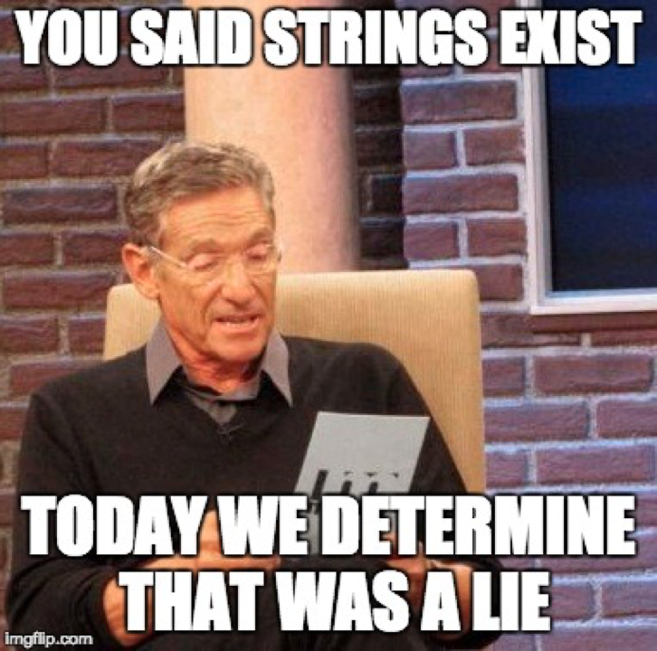
Notes:
compare{0,1,2,3}.c
DRAW compare3

Slide 142
string

Slide 143
char *
Notes:
copy0.c, DRAW copy0

Slide 144
malloc
free
…
Notes:
copy{1,2}.c, DRAW copy2

Slide 145
valgrind
Notes:
copy3.c
memory.c

Slide 146
void swap(int a, int b)
{
}
Notes:
swapping demo

Slide 147
void swap(int a, int b)
{
int tmp = a;
a = b;
b = tmp;
}
Notes:
noswap.c

Slide 148
void swap(int a, int b)
{
int tmp = a;
a = b;
b = tmp;
}

Slide 149
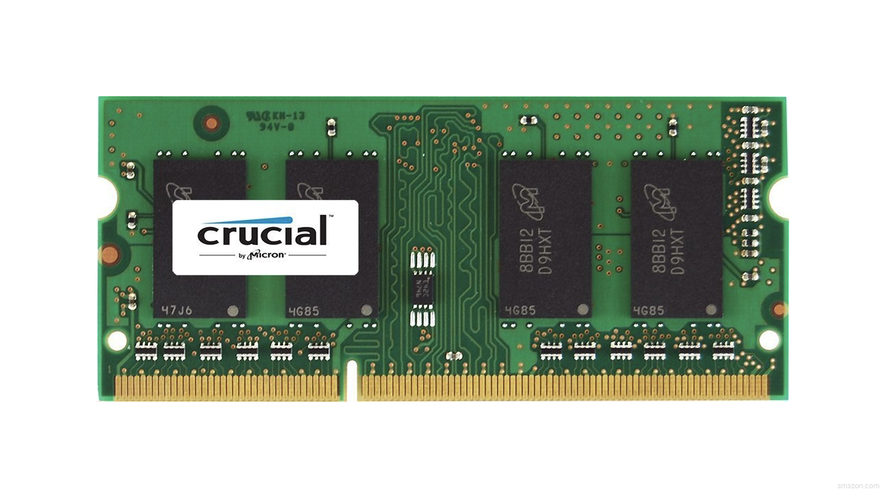

Slide 155
↑
stack

Slide 156
machine code
↑
stack

Slide 157
machine code
globals
heap
↓
↑
stack

Slide 158
machine code
globals
heap
↓
↑
stack

Slide 159
machine code
globals
heap
↓
↑
stack

Slide 160
machine code
globals
heap
↓
↑
stack

Slide 161
machine code
globals
heap
↓
↑
stack

Slide 162
↑
stack
Notes:
show noswap.c again

Slide 163
void swap(int a, int b)
{
int tmp = a;
a = b;
b = tmp;
}

Slide 164
main

Slide 165
swap
main

Slide 166
main

Slide 167
x
y

Slide 168
1
x
2
y

Slide 169
swap
1
x
2
y

Slide 170
a
b
tmp
1
x
2
y

Slide 171
1
a
2
b
tmp
1
x
2
y

Slide 172
int tmp = a;
a = b;
b = tmp;
1
a
2
b
tmp
1
x
2
y

Slide 173
int tmp = a;
a = b;
b = tmp;
1
a
2
b
1
tmp
1
x
2
y

Slide 174
int tmp = a;
a = b;
b = tmp;
2
a
2
b
1
tmp
1
x
2
y

Slide 175
int tmp = a;
a = b;
b = tmp;
2
a
1
b
1
tmp
1
x
2
y

Slide 176
2
a
1
b
1
tmp
1
x
2
y

Slide 177
1
x
2
y

Slide 178
void swap(int a, int b)
{
int tmp = a;
a = b;
b = tmp;
}

Slide 179
void swap(int *a, int *b)
{
int tmp = *a;
*a = *b;
*b = tmp;
}
Notes:
swap.c

Slide 180
1
x
2
y

Slide 181
a
b
tmp
1
x
2
y

Slide 182
int tmp = *a;
*a = *b;
*b = tmp;
a
b
tmp
1
x
2
y

Slide 183
int tmp = *a;
*a = *b;
*b = tmp;
a
b
1
tmp
1
x
2
y

Slide 184
int tmp = *a;
*a = *b;
*b = tmp;
a
b
1
tmp
2
x
2
y

Slide 185
int tmp = *a;
*a = *b;
*b = tmp;
a
b
1
tmp
2
x
1
y

Slide 186
a
b
1
tmp
2
x
1
y

Slide 187
2
x
1
y

Slide 188
void swap(int a, int b)
{
int tmp = a;
a = b;
b = tmp;
}

Slide 189
void swap(int *a, int *b)
{
int tmp = *a;
*a = *b;
*b = tmp;
}
Notes:
swap.c

Slide 190
machine code
globals
heap
↓
↑
stack

Slide 191
heap
↓
↑
stack

Slide 192
heap overflow
stack overflow

Slide 193
buffer overflow

Slide 194
get_char
get_double
get_float
get_int
get_long
get_string
...

Slide 195
scanf
...
Notes:
scanf{0,1,2}.c

Slide 196
file I/O
Notes:
phonebook.csv

Slide 197
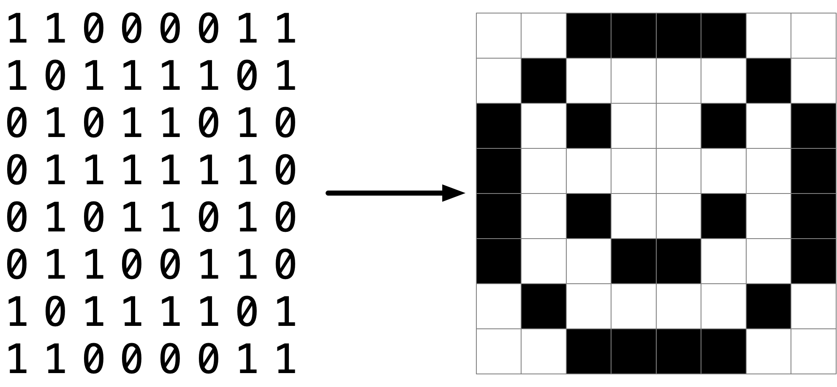

Slide 198
Notes:
jpeg.c

Slide 199

Notes:
https://www.youtube.com/watch?v=i3gv2zOmJiA

Slide 200


Slide 201


Slide 202


Slide 204

Notes:
https://www.youtube.com/watch?v=17MctJPzR8w

Slide 205
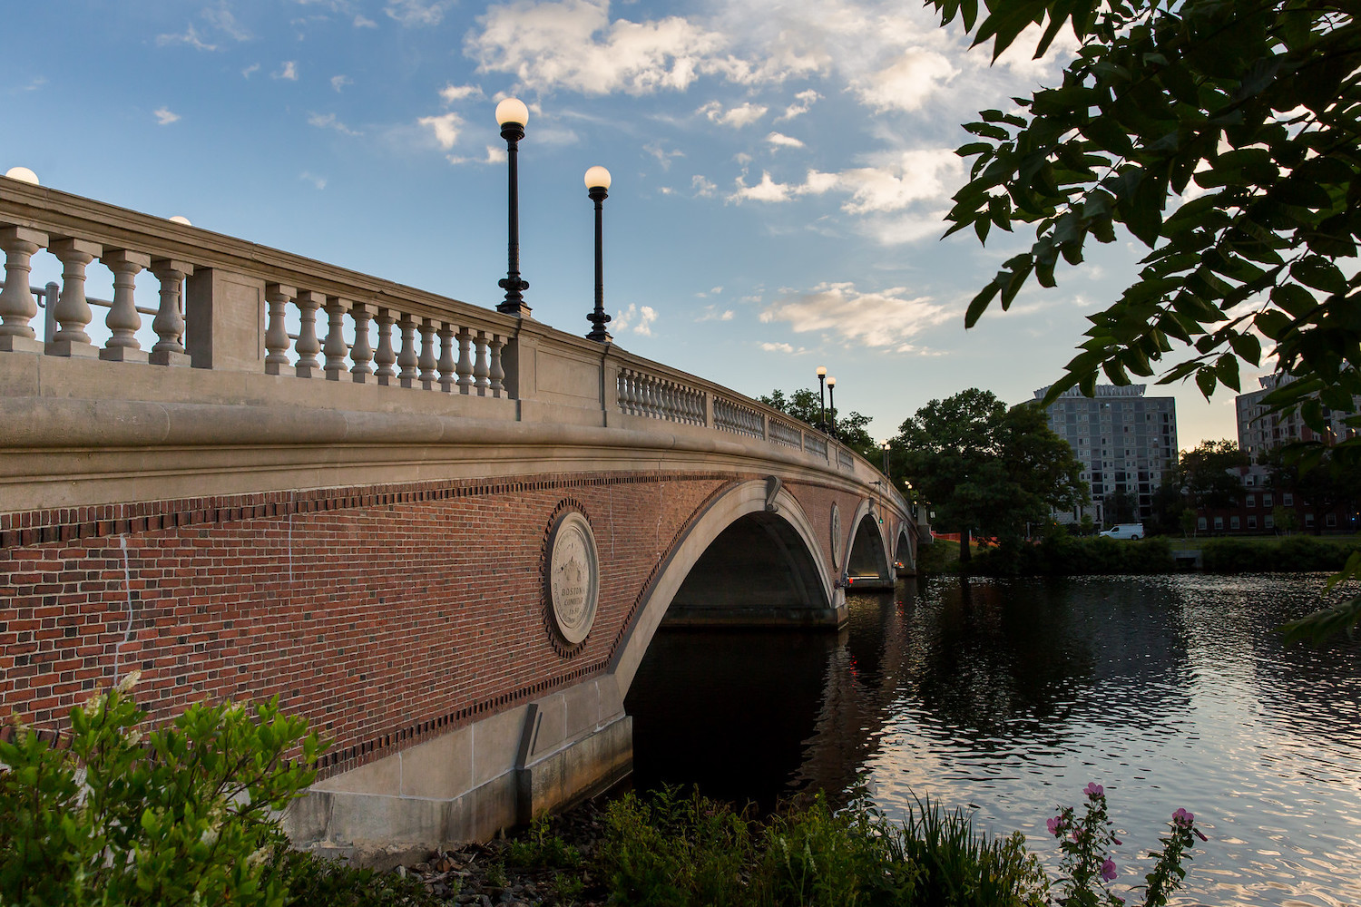

Slide 206
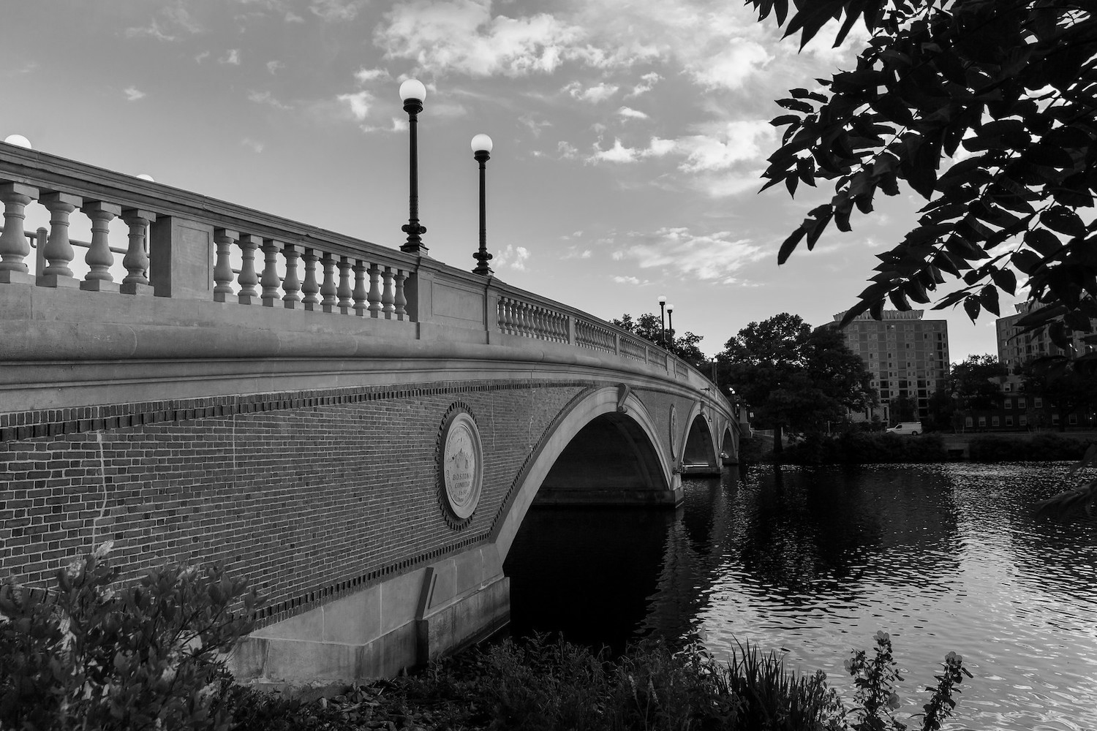
Notes:
grayscale

Slide 207
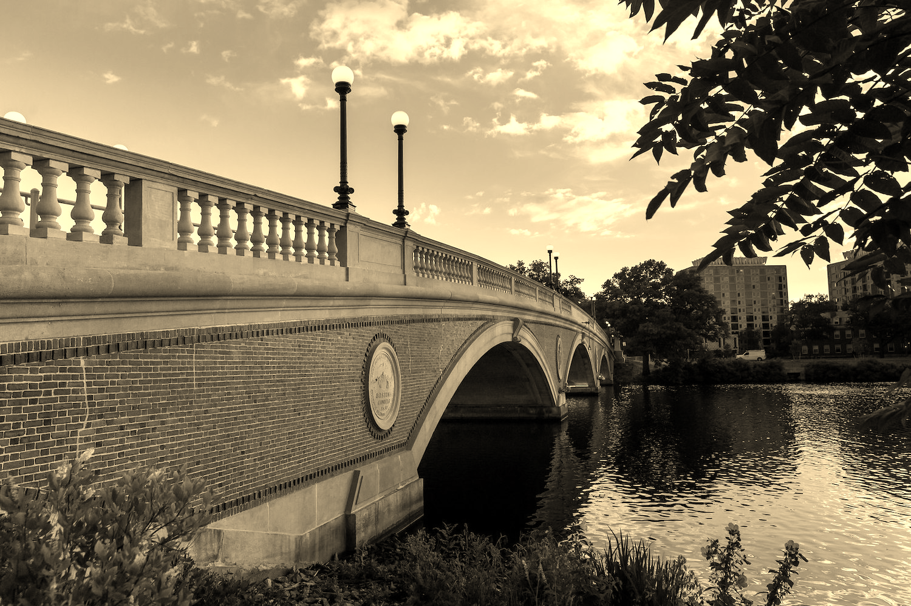
Notes:
sepia

Slide 208
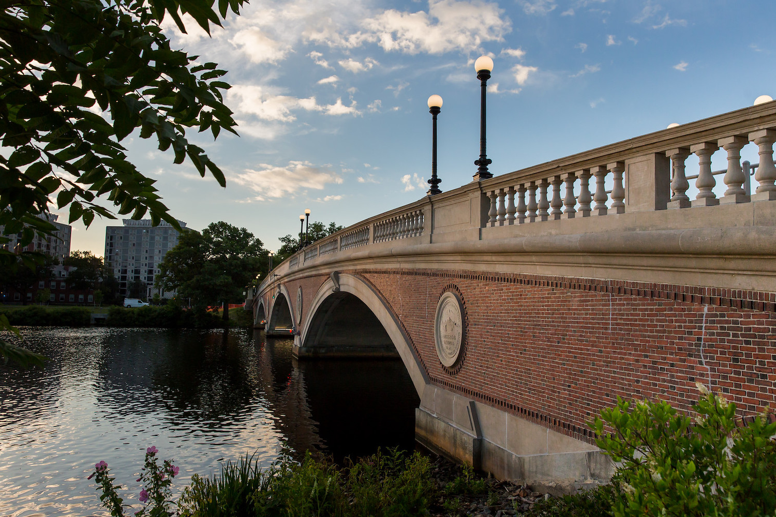
Notes:
reflect

Slide 209

Notes:
blur

Slide 210
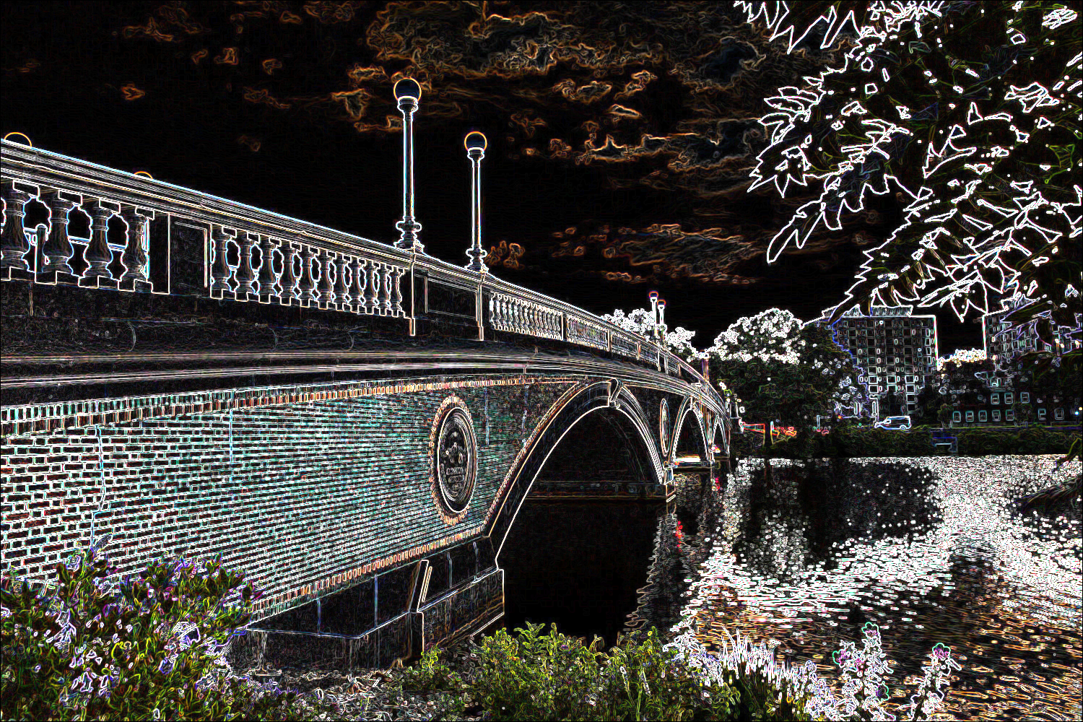

Slide 211
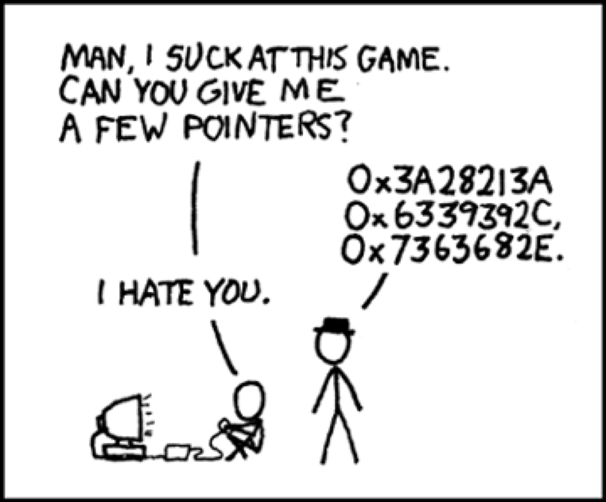

Slide 212
This is CS50

